Slide 1


Case Study: EDA With Student Performance Factors
By Irdam Elba Septian

Slide 2
TABLE OF CONTENTS
INTRODUCTION
01
04
DATA PREPROCESSING
GOOGLE COLABORATORY
02
05
EXPLORATORY DATA ANALYSIS
EDA: EXPLORATORY OR EXPLANATORY
03
06
CONCLUSION

Slide 3
INTRODUCTION
Hello! My name is Irdam Elba Septian and I am a student in Business Intelligence batch 12 at dibimbing.id. In this slides I’m about to share my mini project with you. I’ll be using tools such as Google Colab to do EDA and statistical analysis in Python

Slide 4
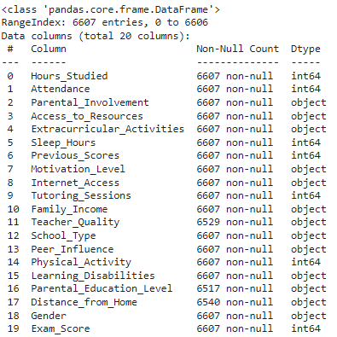
INTRODUCTION
In this example, I will be using a Student Performance Factors dataset to perform EDA and statistical analysis
As shown in the image, the dataset contains 20 columns and 6,607 rows.
If you’d like to learn more about the dataset, you can visit here
If you also like to look at the full coding of this project, you can also visit here

Slide 5

What is a Google Colaboratory?
Google Colaboratory is a cloud-based platform that allows users to write and execute Python code directly in their web browser. It provides an environment for machine learning, data analysis, and other computational tasks, offering free access to GPUs and TPUs.
Google Colab is widely used for collaborative coding, especially for data science and artificial intelligence projects, as it enables users to share and execute notebooks seamlessly.

Slide 6
EDA: EXPLORATORY OR EXPLANATORY
In the field of data, people often hear the term "EDA," which is commonly understood as Exploratory Data Analysis. However, there is another term also referred to as EDA: Explanatory Data Analysis. So, what is the difference between the two?
Exploratory Data Analysis (Exploratory EDA) is the process of analyzing datasets to discover patterns, relationships, and anomalies without having predefined expectations. It involves generating insights and formulating hypotheses by using various visualizations and summary statistics.
Explanatory Data Analysis (Explanatory EDA), on the other hand, focuses on communicating specific insights and findings that have been uncovered, often after the exploratory phase.

Slide 7
Data Preprocessing
Data preprocessing is the crucial step in preparing raw data for analysis or modeling. It involves transforming the raw dataset into a clean, structured, and usable form.
This process ensures that data is accurate, complete, and formatted in a way that enables efficient analysis.

Slide 8
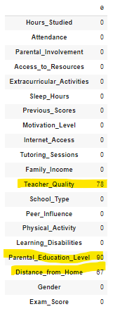
Data Preprocessing
The first step in data preprocessing is to determine whether the dataset contains any null values. In Python, we can use specific code to check for these missing values. After running the code, the data may look like the image provided.
As you can see on the image the columns Teacher_Quality, Parental_Education_Level, and Distance_from_Home

Slide 9
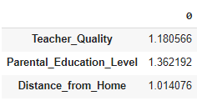
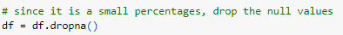
Data Preprocessing
After identifying null values in the dataset, there are several methods to handle them. However, the first step is to determine what percentage of the total data these missing values represent.
As shown in the image, only about 1% of the data contains missing values. Therefore, it is acceptable to delete, or in Python terms, "drop" the data.

Slide 10
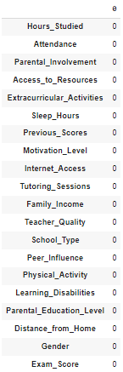
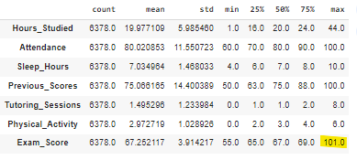
Data Preprocessing
Now as you can see, there are no missing values anymore.
Data preprocessing doesn't stop there. As shown in the image, I used the describe function in Python to get an overview of the values, and it turns out the maximum value for Exam_Score is 101, which doesn't make sense. Therefore, I decided to exclude it from the dataset.

Slide 11
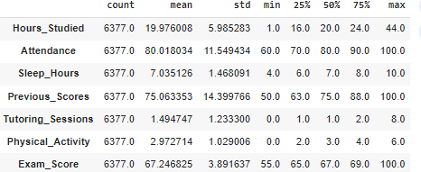
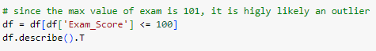
Data Preprocessing
After being excluded, the max value decrease to 100

Slide 12
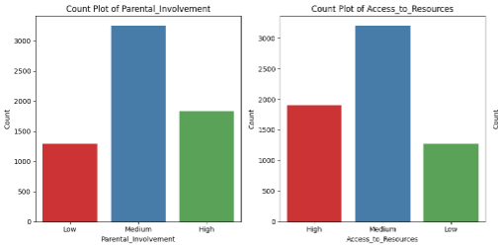
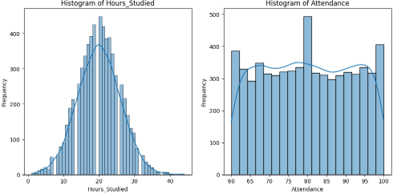
EXPLORATORY DATA ANALYSIS
For EDA, I first decided to visualize the categorical and numerical columns separately to get a general overview of the data.
I used bar chart for categorical and histogram for numerical
Here is the example of the categorical column
Here is the example of the numerical column

Slide 13
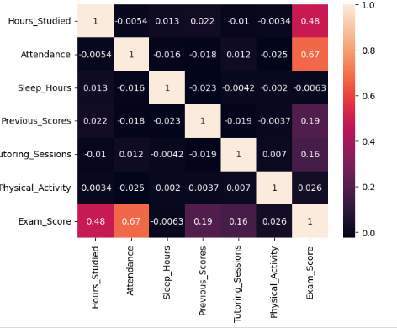
EXPLORATORY DATA ANALYSIS
After I know the general overview of data, I want to know the correlation between numerical columns. Which columns have strong relationship weather its positive or negative, especially the one involving Exam_Score.
As shown in the image, the columns that has the strongest relationship with Exam_Score are Hours_Studied and Attendance with 0.48 and 0.67 respectively.

Slide 14
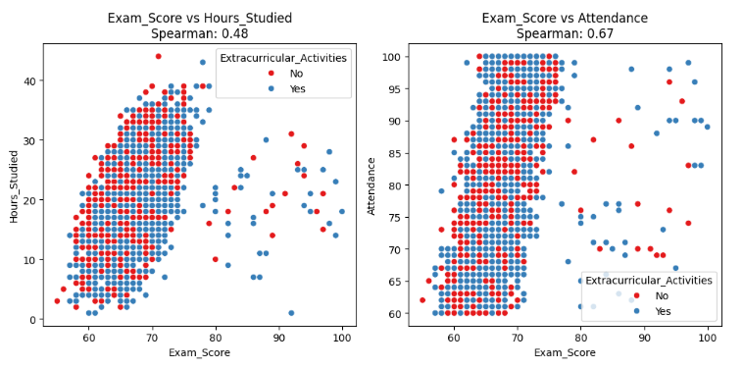
EXPLORATORY DATA ANALYSIS
After seeing the correlation, I checked the chart to confirm it. The chart clearly shows there is a correlation between extracurricular activities, study hours, attendance, and exam scores.
I want to understand why there are dots on the scatterplot that are far apart. I added 'Extracurricular_Activities' to see if students with high study hours and attendance are also involved in extracurricular activities.
As shown in the image, it appears that individuals who participate in extracurricular activities can also exhibit high study hours, strong attendance, and high exam scores. This suggests that involvement in extracurricular activities does not necessarily limit academic performance.

Slide 15
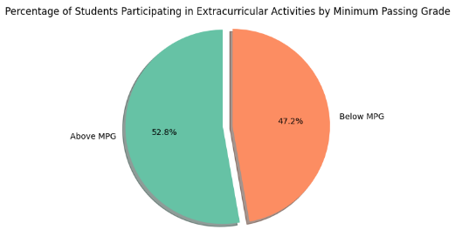
EXPLORATORY DATA ANALYSIS
From the previous slide, we can conclude that exam scores are not influenced by extracurricular activities. However, to be certain, let's check the percentage.
Now, let's determine an imaginary minimum passing grade (MPG), for example, 75, and check the percentage of students who participated in extracurricular activities.
As shown in the image, a higher percentage of students (52.8%) scored above the passing grade when they participated in extracurricular activities.

Slide 16
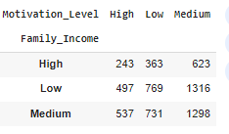
EXPLORATORY DATA ANALYSIS
Next, I want to examine the correlation with categorical variables using a chi-square test. In this case, I will focus on understanding how Family_Income and Teacher_Quality relate to improving the students' Motivation_Level.
First the family income, the hypothesis for this are
And this is the table

Slide 17
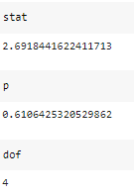
EXPLORATORY DATA ANALYSIS
Using the chi-square function in Python, we obtained a chi-square statistic that is too small for a degree of freedom of 4, and the p-value is also too high. This suggests that we fail to reject the null hypothesis, indicating that there is no significant association between Family_Income and Motivation_Level.

Slide 18
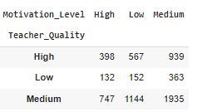
EXPLORATORY DATA ANALYSIS
As for teacher quality and motivation level, first we do the same step as before

Slide 19
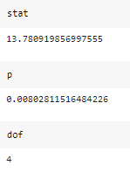
EXPLORATORY DATA ANALYSIS
For the second set of results, we obtained a chi-square statistic of 13.78 with a degree of freedom of 4, and the p-value is 0.008, which is low. This indicates that we reject the null hypothesis, suggesting a significant association between Teacher_Quality and Motivation_Level.

Slide 20
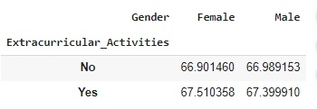
EXPLORATORY DATA ANALYSIS
Now I want to see what categorical columns that actually affected the Exam_Score. I decided to use pivot table in order to visualize it.
As shown in the image, extracurricular activities positively impact exam scores, as both male and female students have higher average scores when participating in these activities. However, we have already confirmed this when discussing correlation.

Slide 21
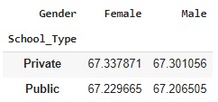
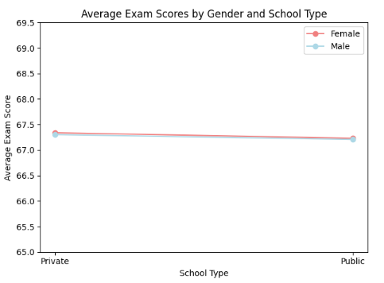
EXPLORATORY DATA ANALYSIS
I also want to examine whether there is a difference between students who attend public schools and those who attend private schools.
As shown on the picture, there is almost no difference between the two of them in relation to exam score.

Slide 22
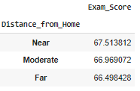
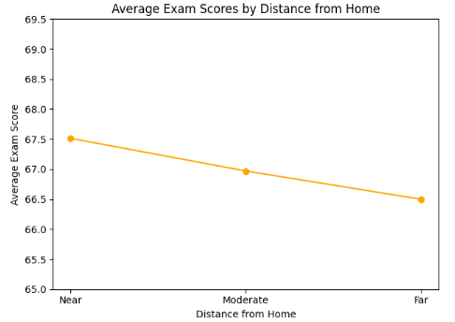
EXPLORATORY DATA ANALYSIS
I also want to examine whether there is a difference in the distance the students have to go through in relation to exam score.
As shown on the picture, Near distance have a higher average.

Slide 23
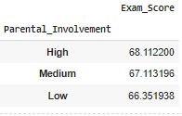
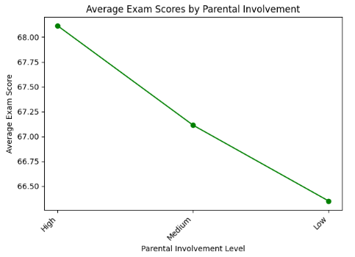
EXPLORATORY DATA ANALYSIS
I also want to examine whether there is a difference in parental involvement toward the exam score
As shown on the picture, student with high parental involvement tend to score higher in exam.

Slide 24
CONCLUSION
The columns that have the most correlation with Exam_Score are Hours_studied and Attendance.
Extracurricular activities did not affect exam scores, as demonstrated by the fact that more than 50% of students scored above 75. This is further supported by the visualization and pivot table, which show that extracurricular activities had no significant impact on exam scores for either gender.
Using chi-square test, it is known that there is no significant association between Family_Income and Motivation_Level.
Using chi-square, it is known that there is significant association between Teacher_Quality and Motivation_Level. That is why the school could improve the quality of the teacher.

Slide 25
CONCLUSION
Female students tend to have higher average exam scores than male students in both private and public school settings, although the differences are minimal.
Proximity to school appears to correlate with better exam performance, indicating that students who live closer tend to perform better academically.
Higher levels of parental involvement are positively associated with improved exam scores, suggesting that engaged parents can enhance academic performance.

Slide 26
CONCLUSION
Encouraging participation in extracurricular activities and enhancing parental involvement may lead to better academic outcomes for students.
Additionally, strategies to support students living farther from school could help improve their performance.

Slide 27
THANK YOU

